Slide 1
Project Management
Atlantis Project – Thomas DROUIN, Mathieu Jubenot, Victor Schirmann, Simon TODESCHINI

Slide 2
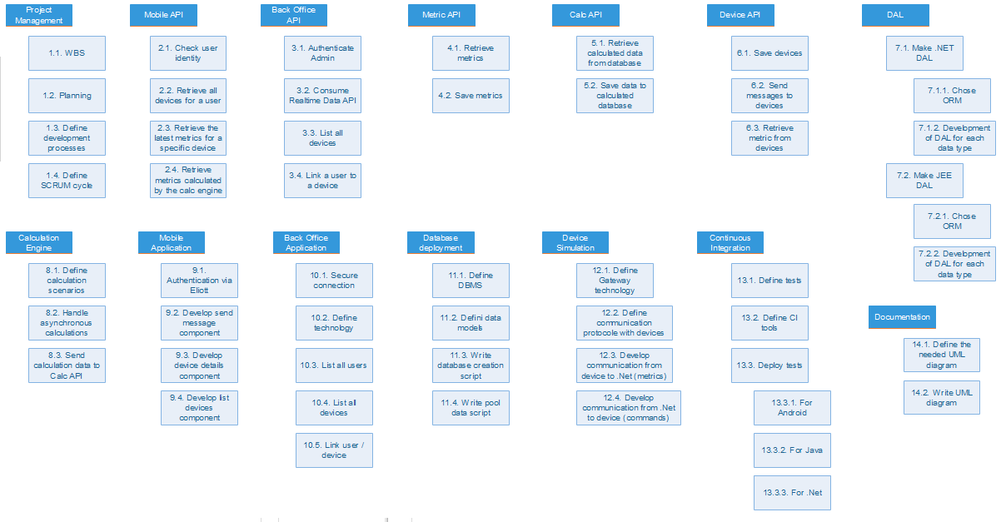
Work Breakdown Structure

Slide 3
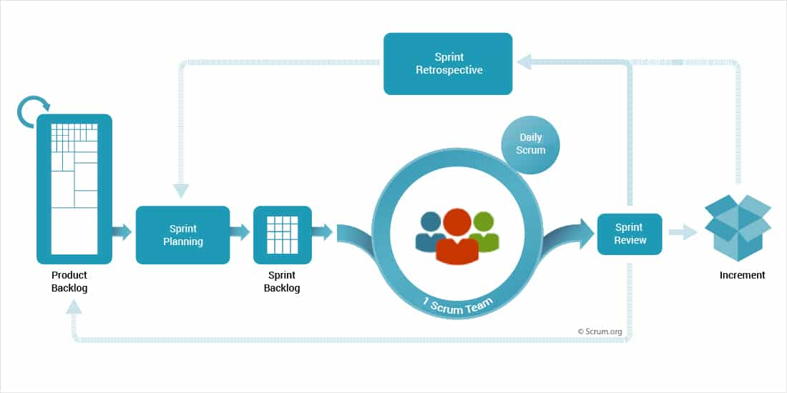
Project Management Method Scrum Methodology
We will handle this project using Scrum, a focused yet flexible project management strategy that consists in working through an iterative software development process.
Unlike the average scrum method implementations, we decided to make 3-days sprints because of the relatively short time which is given to us for this project. Except this, we will handle Scrum in a very classic way that will be explained on the next panels.

Slide 4

Project Management Method Daily Scrum Meetings
A Daily Scrum Meeting will be done every morning in order to ensure everything is on track and everyone has the tools they need.
From these meetings will be written daily reports which contains for each developer :
What they have done on the previous day
What they are planning to do today
These meetings are also intended to discuss about potential problems that could have been encountered by a developer during the previous day.

Slide 5
Project Management Method Lifecycle and kanban
For our project we will use the following kanban in order to manage our tasks for each sprint.
When a sprint is ended, all the done tasks will be moved to the archive column and the Release Backlog (Sprint 1) column will be replaced with a Release Backlog (Sprint 2) column.

Slide 6
Project Management Method Release Backlog
Release backlogs will be done with the tasks that we defined in our work breakdown structure.
For each release, we will

Slide 7



Collaborative tools
Github will be used for our versionning. Each push has to be validated by doing a pull request. The team members will then look at the pull request and comment it. If everyone agrees to it, then it is accepted.
Slack will be used in order to handle team discussions and having a way to contact members of the team at any time.
Our kanban table will be made using Trello. All members will have access to it and we will be able to handle our tasks using this very useful tool

Slide 8
Description of the continuous integration practices

